Slide 1
Assumptions
Quarterly dash board to President
Reports progress
Reports on levers/opportunities to change
Fiscal Year = Calendar Year
Important Things
Digestibility, quick to understand
Good design
Adhere to good viz principles (color blind, good charts)
dollar by Alice Design from the Noun Project
Contacts by AliWijaya from the Noun Project

Slide 2
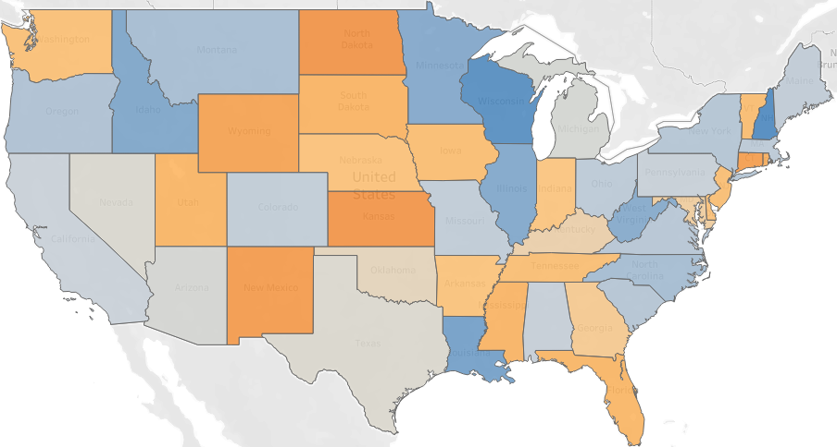
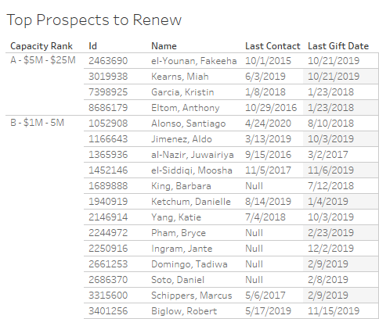
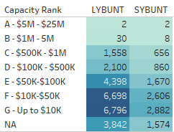
Fundraising Year to Date: Jan - Sept
2020 Goal: $1.15B
2018
$280M to raise in Q4
2017
2020
2019
2020 YTD: $870M
2020 Dollars Raised vs 2019
Portfolio Metrics: % of Donor HH Giving and Contacted
Donated
Contacted
Opportunity in Midwest
to Renew
2019 Gifts
behind
ahead
Non-Managed Donors to Renew By Capacity
High Capacity Non-Managed Donors for Presidential Contact in Q4
Q4 Focus:
Leadership Attention
Annual Fund
Outreach
Development to provide talking points and contact info.
Development leadership to contact remaining list.

Slide 3
2020
2020 YTD: $870M
2020 Goal: $1.15B
$280M to raise in Q4
2017
2019
2018

